Slide 1
Predict congestion levels on roads
Abdullah Hafiz
Khaled Binasker
Abdulmalik Faden
Taher Mutanbak
Minin project week5

Slide 2
Project steps
Choose the idea
Data collection
Data visualization
Model evaluation
Model

Slide 3
Project overview
In this project, we developed a model utilizing SimpleRNN, Long Short-Term Memory (LSTM) and Gated Recurrent Unit (GRU) networks to predict congestion levels on roads.

Slide 4
Dataset
The dataset, sourced from Kaggle, included timestamped data detailing congestion levels across multiple road directions , such as southbound and eastbound
Data | Describtion | Column
[0-849k] | a unique identifier for this instance | row_id
[yy-mm-dd hh:mm:ss] | the 20-minute period in which each measurement was take | time
[0,1,2] | the east-west midpoint coordinate of the roadway | x
[0,1,2,3] | the north-south midpoint coordinate of the roadway | y
[EB,NB,NE,NW,SB,SE,SW,WB] | the direction of travel of the roadway. EB indicates "eastbound" travel, for example, while SW indicates a "southwest" direction of travel. | direction
[0-100] | congestion levels for the roadway during each hour; the target. The congestion measurements have been normalized to the range 0 to 100 | congestion

Slide 5
Data preprocessing
We took a general overview of all directions, chose the most crowded direction, chose it, took data related to this direction, and created models on it.

Slide 6
Coding steps
Import libraries
Load data
Preprocessing
Visualization
model.compile
modeling
Data splitting
Normalize
training
predict
Visualization of results

Slide 7
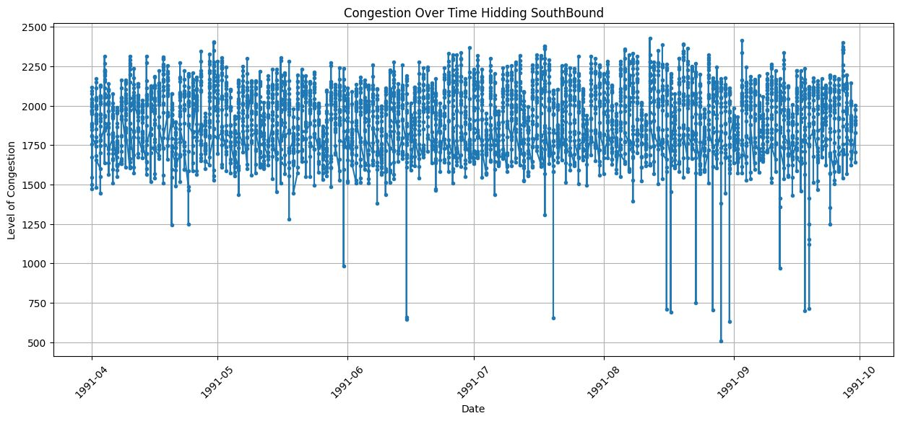
Data visualization

Slide 8
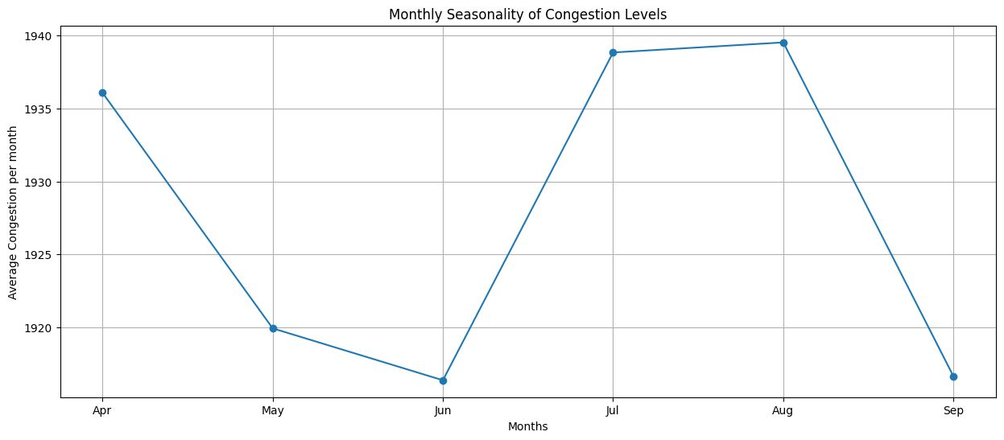
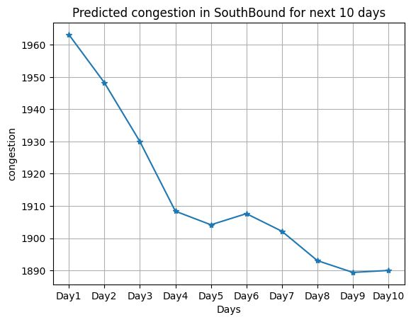
Cont. Data visualization

Slide 9
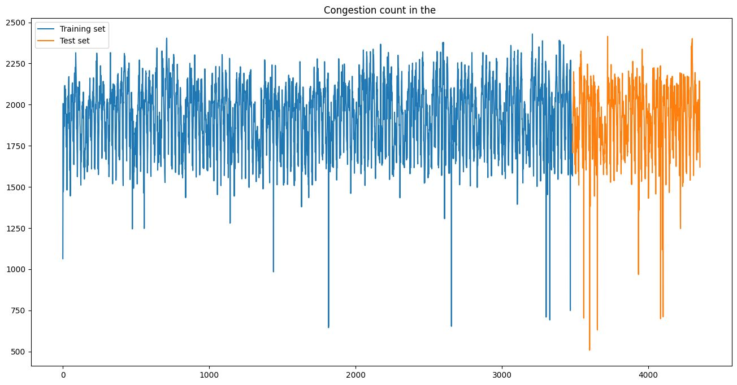
Data SPLITING

Slide 10
The model
The model was designed to analyze temporal patterns in the data to provide accurate predictions, aid in better traffic management and planning.

Slide 11
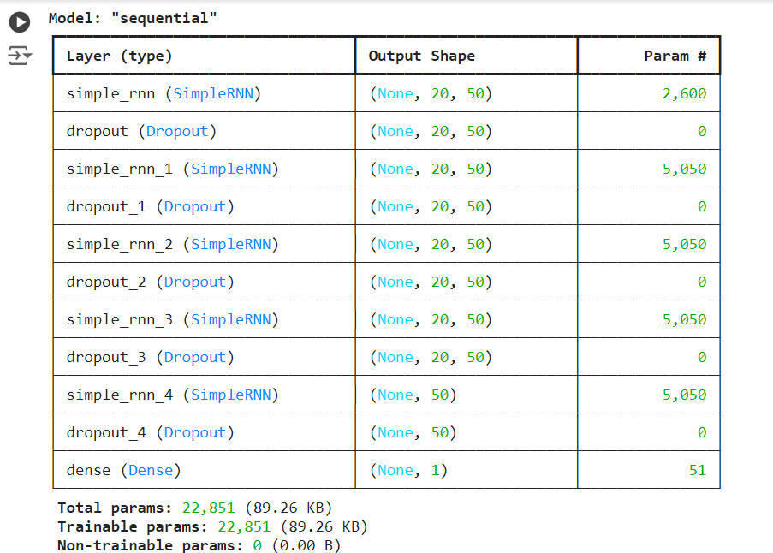
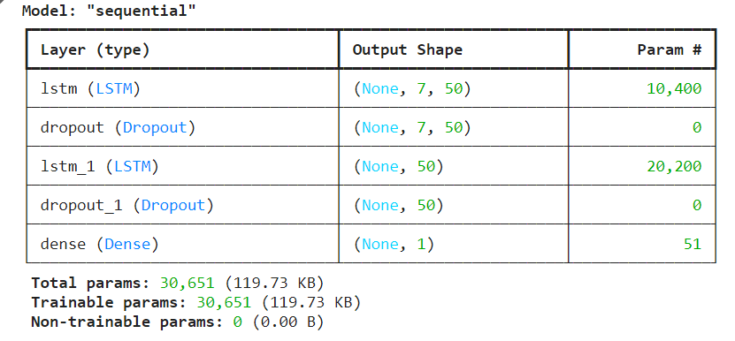
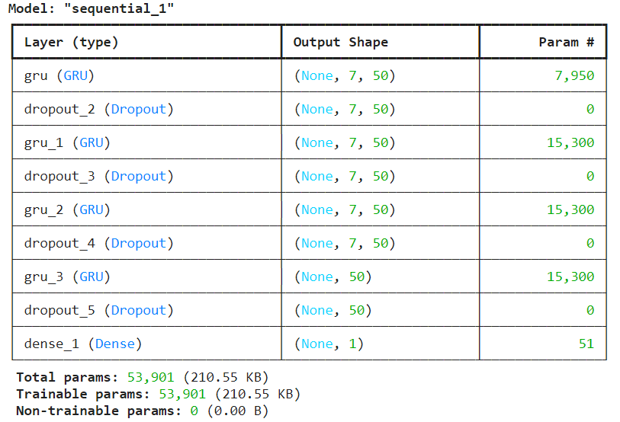
Models:
SimpleRNN
LSTM
GRU

Slide 12
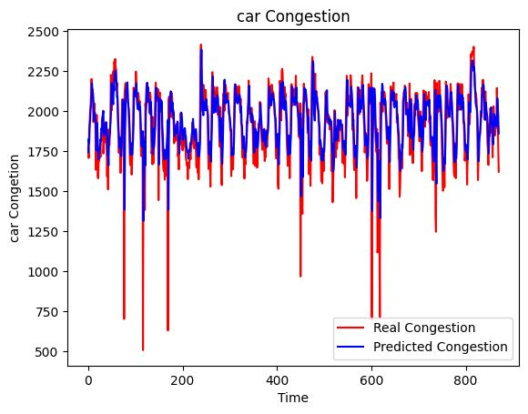
Model evaluation - LSTM
RMSE: 172.66

Slide 13
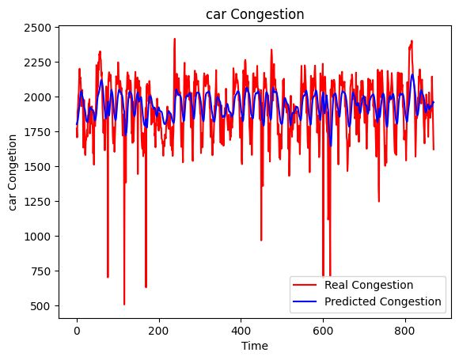
Model evaluation - GRU
RMSE: 202.31

Slide 14
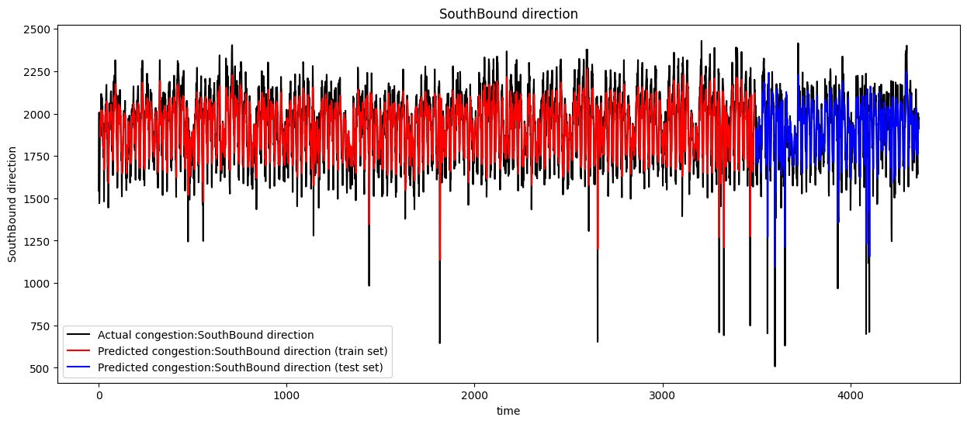

Model evaluation - RNN
RMSE: 1912.85

Slide 15
Thank You

